Slide 1
CPE 133
Experiment 1 Overview
New Gates
Function Forms
Experiment 2 Introduction

Slide 2
Experiment #1: The Point
What you did:
Designed, modeled, and implemented standard digital circuit on an FPGA
Used Boolean equations to define outputs in terms of inputs
How you did it:
Used the Vivado design tools suite
Xilinx Design Methodology
How you tested your design:
You did a visual test

Slide 3
Function Representations
Standard Sum of Products (SOP)
Write an expression for the 1’s
Standard Product of Sums (POS)
Write an expression for the 0’s
DeMorganize it
Minterm: product term containing all independent variables of the function
Maxterm: sum term containing all independent variables of the function
Maxterm = !(Minterm)
Minterm = !(Maxterm)
Functional Equivalence

Slide 4
Representing Functions
Standard SOP & POS (equations)
Compact minterm & Compact maxterm
Circuit form (schematic)
Truth table
You should be able to go from any one form to any other form

Slide 5
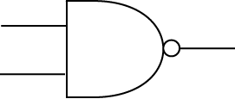
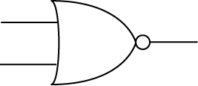
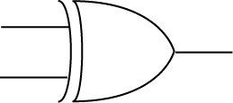
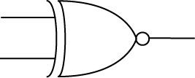
New Gates
NAND Gate
NOR Gate
XOR
XNOR
Functionally Complete
Functionally Complete

Slide 6
Circuit Forms
Many Different circuit forms
We’ve worked with about 10 of them
“circuit forms” refers to basic implementation styles
Some styles are more useful than others
Styles you’re used to:
AND/OR (SOP)
OR/AND (POS)
Standard circuit forms come from SOP and POS forms and applications of DeMorgan’s theorems

Slide 7
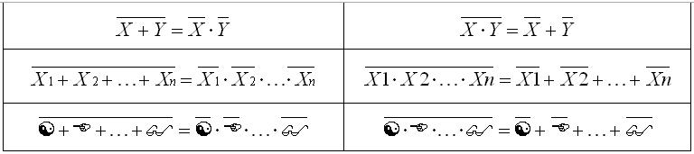
DeMorgan’s Theorem
General form
Most used theorem in digital design

Slide 8
Example: the 8 Standard Circuit Forms
F(A,B,C) = SUM(0,1,7)

Slide 9
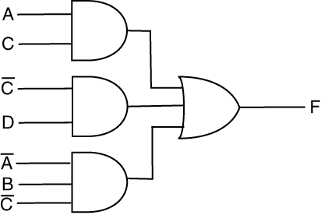
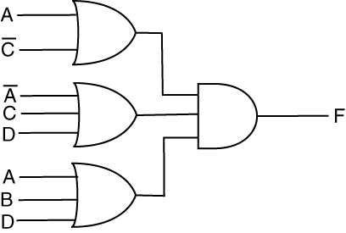
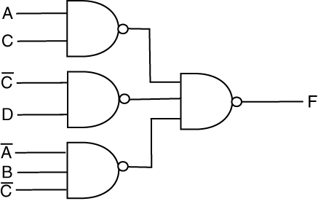
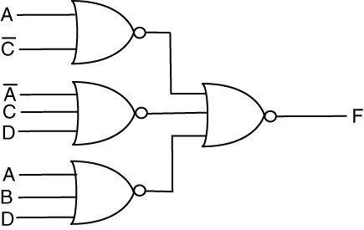
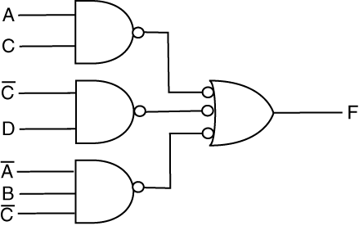
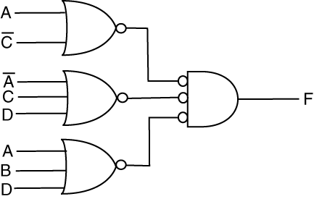
Drawing NAND/NAND & NOR/NOR Circuits
AND/OR
OR/AND
Bad NAND/NAND
Bad NOR/NOR
Good NAND/NAND
Good NOR/NOR

Slide 10
HDL Thoughts
HDL: Hardware Description Language
presents an unambiguous way to model digital circuits
models allow for the circuit simulations
Verilog supports hierarchical modeling
Verilog models can be used to generate actual circuits
Verlog is not:
VHDL is not a programming language
as the name states, it’s a description language
Bad at and/or dislike programming?
You’re modeling digital circuit

Slide 11
VHDL Invariants
Case Sensitivity:
case sensitive
White space:
white space is ignored
Comments:
anything after a “// “ (two slashes) is ignored
“block” comments /* */ (multiline comment)
Parenthesis:
few requirements; use for code clarity
operator precedence??

Slide 12
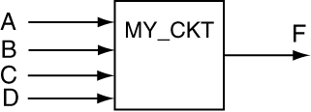
Example
Implement the following function:
module my_ckt (A,B,C,D,F);
input A,B,C,D;
output F;
assign F = (A & ~B) | (C & ~D);
endmodule

Slide 13
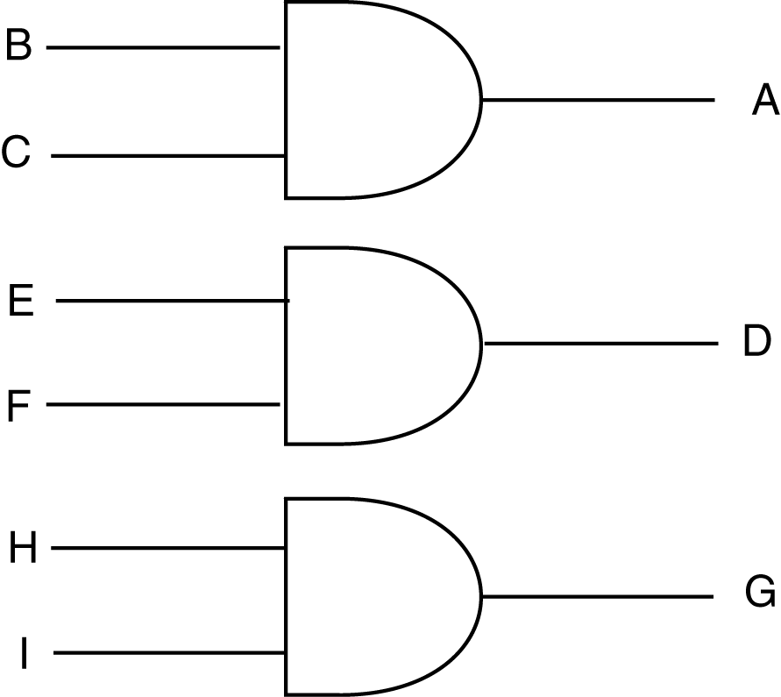
Verilog & Concurrency
Higher-level Language
A = B + C;
D = E + F;
G = H + I;
VHDL
assign A = B & C;
assign D = E & F;
assign G = H & I;

Slide 14
2 Types of Concurrent Statements
Continuous Assignment
always blocks
Notes:
This is a list of the four major types of concurrent statements used in VHDL. The previous example showed concurrent signal assignment. This set of slides talks about the first three. The next set of slides will talk about process statements.

Slide 15
Operators
AND: &
Example: A & B
OR: |
Example: A | B
Inversion: ~
Example: ~A
NAND: ~(A & B)
NOR: ~(A | B)

Slide 16
Experiment #2: Full Adder (FA)
Full Adder in SOP & POS forms
Assignment B only
Objectives: to prove SOP and POS forms are functionally equivalent
Use any switches and LEDs you want
Lab Submissions
Not a “lab report”
Read the Lab Manual for details
Don’t ever submit constraints file

